Slide 1

Notes:
Trainer to give a crisp Self Introduction and then introduce FACE.

Slide 2
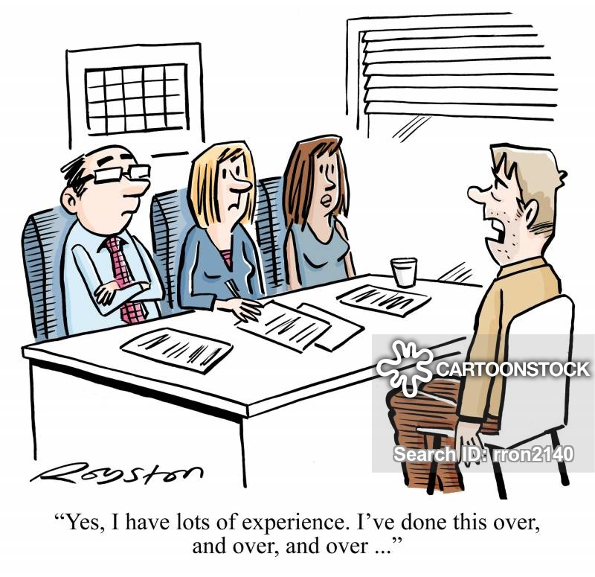

Panel Interview
Notes:
Panel interview refers to a type of interview which includes one applicant and several interviewers, often representatives of different departments within a company like the hiring manager and a member of the human resource recruitment team.

Slide 3
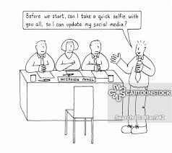
What is Panel Interview?
Notes:
A Panel Interview is an interview where you’re meeting with a group of people at once (typically between 2-5) and answering questions posed by all of them. It is important to note that a Panel Interview is different from a Back-to-back Interview where you meet with one person after another on a one-on-one basis. Instead, a Panel Interview means meeting several decision makers at the same time and it is designed to do three things: save the interviewers’ time, assess how well candidates handle pressure and ensure that the hiring decision is a collective one.

Slide 4

Group Interview
Notes:
A Group Interview is when an employee or team or employees interviews multiple candidates at the same time.

Slide 5
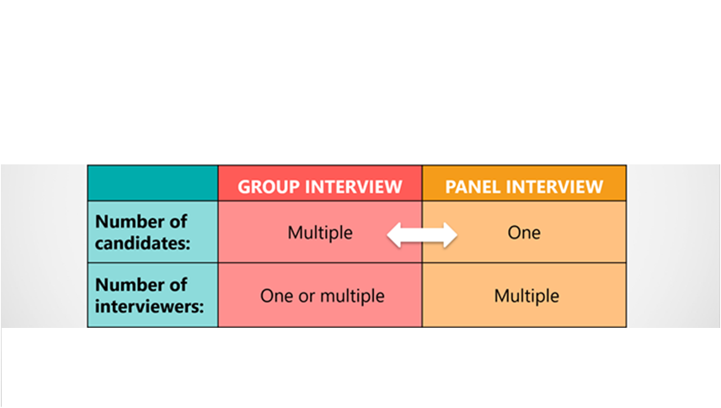
Difference between Group Interview and Panel Interview
Notes:
The Difference between Group Interview and Panel Interview is in the number of job candidates being interviewed at the same time. A Group Interview is a job interview with Multiple Candidates and one or more Interviewers. A Panel Interview is a job interview with Multiple Interviewers, But Only One Candidate.

Slide 6
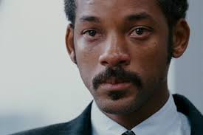
Why Panel Interview?
Notes:
The main reason that companies like panel interviews is that it allows various representatives of the hiring organization, business, or agency to reach a consensus before making a hiring decision. ... The company can schedule one interview instead of coordinating several different one-on-one meetings.

Slide 7

How to Respond to a Panel Interview Invitation?
Notes:
When you receive an invitation to a panel interview, respond right away if they ask you to confirm your availability.
If you absolutely cannot attend, contact them immediately and request an alternative date and time. If you have any questions about the interview, call the office to ask. Be sure to use whatever contact number or email address they have given you.
When preparing for a panel interview, be sure to do some research on both the company and the individual interviewers. You should know their roles within the company and have at least one question prepared for each person. If the company has not supplied details on all interviewers, you can politely ask for a list of everyone you will meet, along with their job titles.
The day or two before the interview, you may also want to confirm the job interview. Call the office to confirm the time and date. You may also want to confirm the location, who you will be meeting with, and how to get there.

Slide 8

Panel Interview Invitation Example
Notes:
Let us look at a “Panel Interview Invitation Example”, spread over the next four slides.

Slide 9
Panel Interview Invitation Example
The following is an example of an email inviting a job seeker to an interview by a panel.
Subject Line of Email Message: Associate Director Interview
Dear Jane Doe,
Thank you for applying for the position of Associate Director of ABC Company.
Notes:
Let us look at a “Panel Interview Invitation Example”.

Slide 10
Panel Interview Invitation Example
We are pleased to invite you to participate in a panel interview.
The details are as follows:
Date: Tuesday, January 28th Time: 10 AM Location: ABC Company 1 Park Drive, Coimbatore, Tamil Nadu
Notes:
Let us look at a “Panel Interview Invitation Example”.

Slide 11
Panel Interview Invitation Example
This will be a panel interview conducted by:
Siva Subramanian, Director of ABC Company
Arumugam N, Director of Human Resources
Raj, President, ABC Company Board of Trustees
Notes:
Let us look at a “Panel Interview Invitation Example”.

Slide 12
Panel Interview Invitation Example
When you arrive, please ask at the front desk for Angeline, and I will escort you to our conference room for your panel interview. We anticipate that the interview will last 45 minutes.
Please call (1234567890) or email me to confirm your interview or to reschedule, if necessary.
We look forward to meeting with you.
Sincerely,
Angeline
Notes:
Let us look at a “Panel Interview Invitation Example”.

Slide 13

Common Questions asked during Panel Interview
Notes:
Trainer to inform students that we are now going to look at some Common Questions asked during Panel Interview.
Interviewers typically ask a mix of behavioural and situational questions, as well as questions about the candidate's personality and career goals.

Slide 14
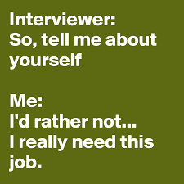
Common Questions asked during Panel Interview
Tell me about yourself.
Notes:
The interviewer wants to know why you're an excellent fit for the job. Try to answer questions about yourself without giving too much, or too little, personal information. You can start by sharing some of your personal interests and experiences that don't relate directly to work, such as a favourite hobby or a brief account of where you grew up, your education and what motivates you. You can even share some fun facts and showcase your personality to make the interview a little more interesting.

Slide 15
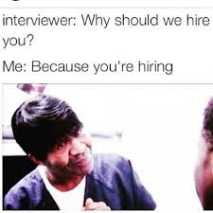
Common Questions asked during Panel Interview
Why should we hire you?
Notes:
Are you the best candidate for the job? The hiring manager wants to know whether you have all the required qualifications. Be prepared to explain why you're the applicant who should be hired. Make your response a confident, concise, focused sales pitch that explains what you have to offer and why you should get the job.

Slide 16

Common Questions asked during Panel Interview
What is your greatest strength?
Notes:
This is one of the questions that employers almost always ask to determine how well you are qualified for the position. When you are asked about your greatest strengths, it's important to discuss the attributes that qualify you for that specific job, and that will set you apart from other candidates.

Slide 17
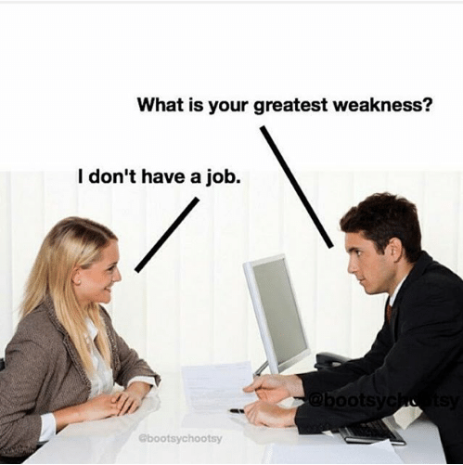
Common Questions asked during Panel Interview
What is your greatest weakness?
Notes:
Another typical question interviewers will ask is about your weaknesses. Do your best to frame your answers around positive aspects of your skills and abilities as an employee, turning seeming “weaknesses” into strengths. You can also share examples of skills you have improved, providing specific instances of how you have recognized a weakness and taken steps to correct it.

Slide 18

Common Questions asked during Panel Interview
What are your salary expectations?
Notes:
The hiring manager wants to know what you expect to earn. It seems like a simple question, but your answer can knock you out of competition for the job if you overprice yourself. If you under price yourself, you may get short changed with a lower offer.

Slide 19
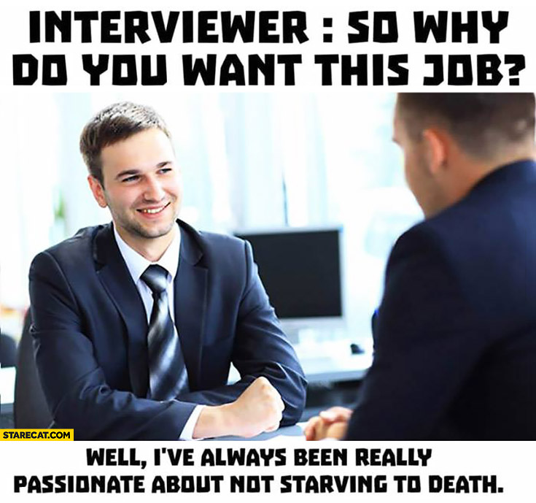
Common Questions asked during Panel Interview
Why do you want this job?
Notes:
This question gives you an opportunity to show the interviewer what you know about the job and the company, so take time beforehand to thoroughly research the company, its products, services, culture and mission. Be specific about what makes you a good fit for this role, and mention aspects of the company and position that appeal to you most.

Slide 20

Common Questions asked during Panel Interview
How do you handle stress and pressure?
Notes:
What do you do when things don’t go smoothly at work? How do you deal with difficult situations? The employer wants to know how you handle workplace stress. Avoid claiming that you never, or rarely, experience stress. Rather, formulate your answer in a way that acknowledges workplace stress and explains how you will overcome it, or even use it to your advantage.

Slide 21

Common Questions asked during Panel Interview
Describe a difficult situation or project and how you overcame it.
Notes:
The interviewer wants to know how you respond when faced with a difficult decision. As with the question about stress, be prepared to share an example of what you did in a tough situation. It is important to share details to make the story believable and engaging.

Slide 22

Common Questions asked during Panel Interview
What are your future goals?
Notes:
This question is designed to find out if you’re going to stick around or move on as soon as you find a better opportunity. Keep your answer focused on the job and the company, and reiterate to the interviewer that the position aligns with your long-term goals.

Slide 23
RECAP ANYONE ?
Notes:
Trainer to ask anyone to re- cap.

Slide 24
RECAP ANYONE ?
What is Panel Interview?
Difference between Group Interview and Panel Interview
Common Questions asked during Panel Interview
Notes:
If any points were left out in the re- cap, Trainer to mention the same and then do a Final Re- Cap.

Slide 25

THANK YOU
Notes:
Trainer to Thank the Students saying that it was a good session and re- iterate the usefulness of the session.

